Slide 1




Apple
BUSI2045 Section 4

Slide 2


Agenda
Research
questions
Data
description
01
02
Survey questionnaire design
03
Conclusions & Recommendations
Data tidying
Data analysis
04
05
06

Slide 3

Research questions
How customers evaluate Apple?
How to improve Apple’s brand image?

Slide 4
Survey questionnaire design
Qualtrics survey with 17 questions
Data is collected through social media
Data type: nominal, interval
Type of questions: open-ended questions, dichotomous, rating, multiple choice
Measurement of questions: 5-point scale, simple category scale

Slide 5
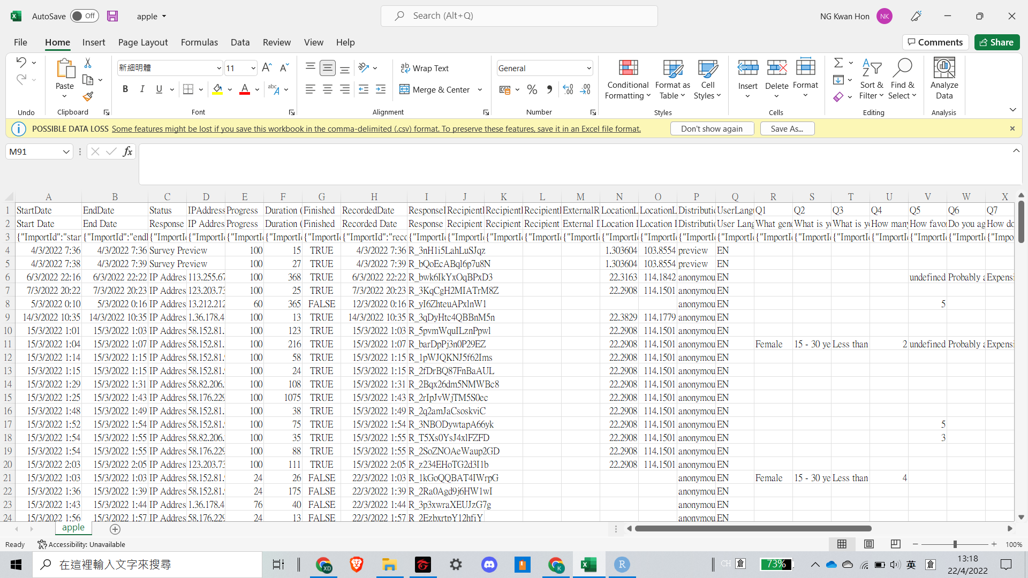
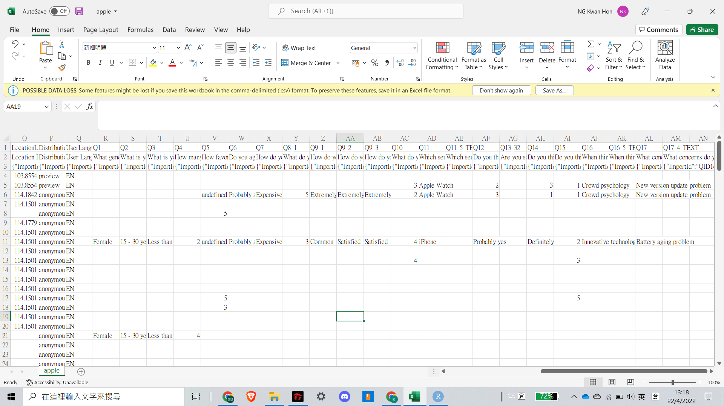
Data’s description
168 observations of 39 variables

Slide 6



Data tidying
01
02
03
04
05
06
select finished data
select useful variables
replace data which contains "" & "undefined" with NA
Change data structure
replace NA with the median for rating type questions
select completed data

Slide 7
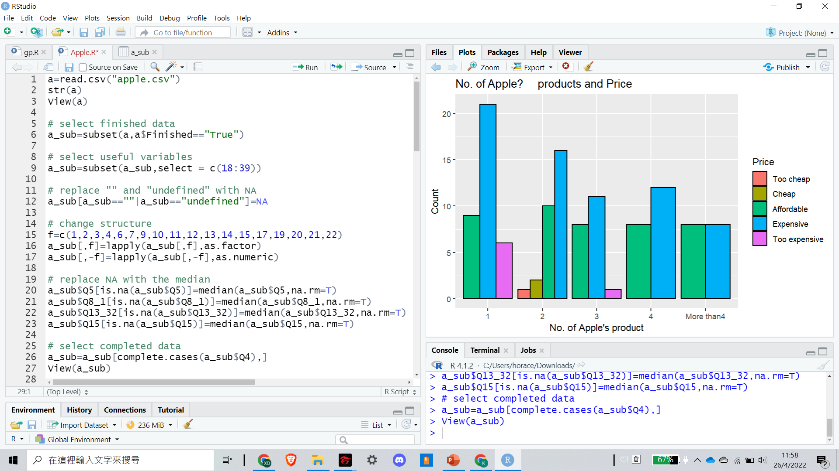
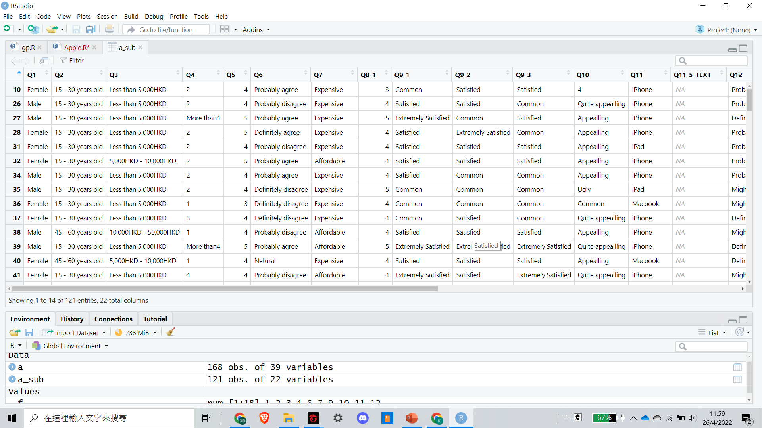
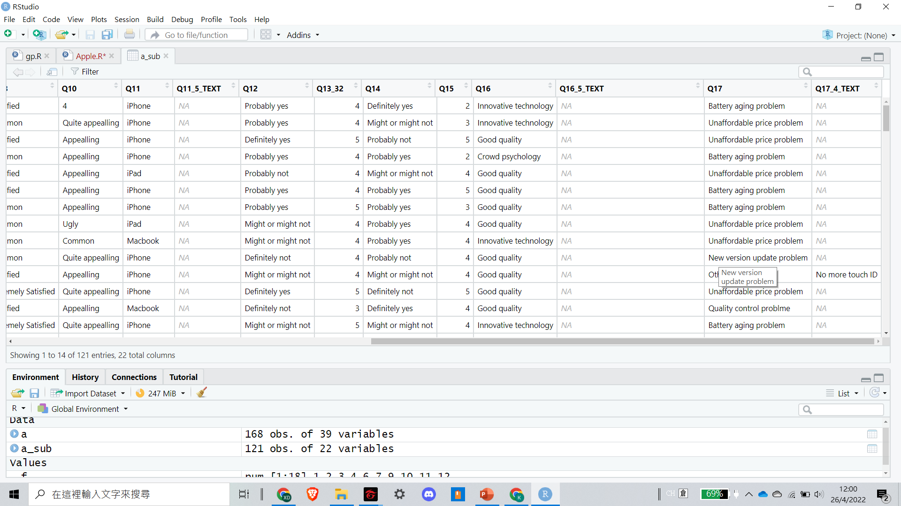
Data tidying
121 observations of 22 variables

Slide 8
Data Analysis

Slide 9
Analysis 1 - 3

Slide 10
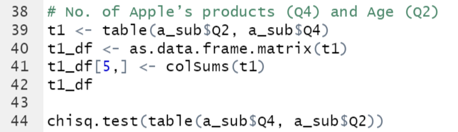
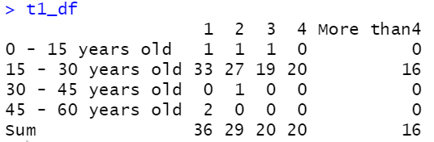
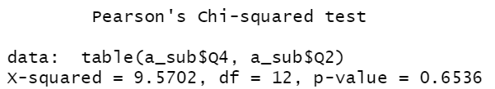
(1) No. of Apple’s products and Age
Null hypothesis (H0): Age and the number of Apple’s product are unrelated.
Alternative hypothesis (H1): Age and the number of Apple’s product are related.
P-value > 0.05
Not to reject H0.
So we conclude age and the number of Apple’s product do not have a significant relationship.

Slide 11
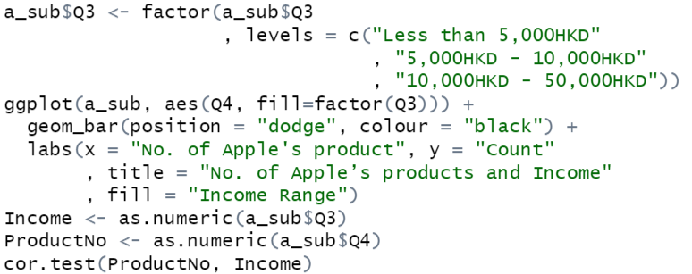
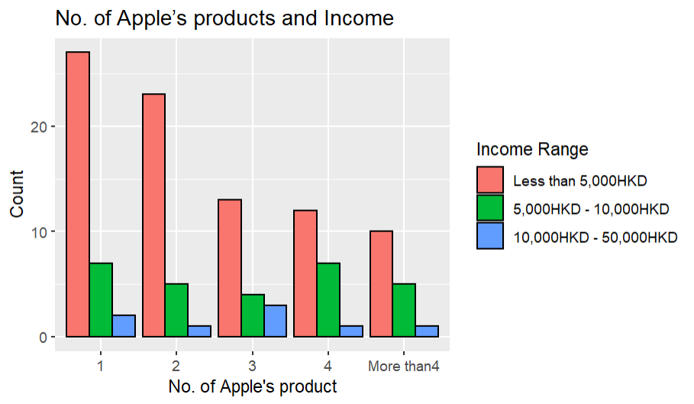
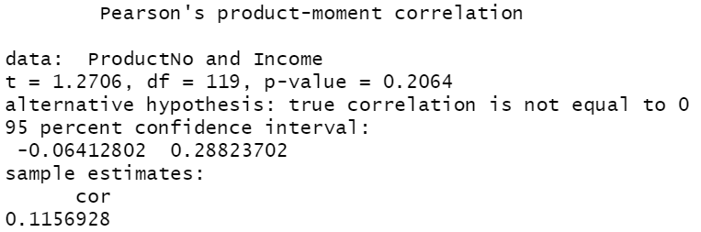
(2) No. of Apple’s products and Income
Null hypothesis: True correlation is equal to 0
P-value > 0.05
Not to reject H0.
So there is no relationship between income and the no. of Apple’s product.

Slide 12
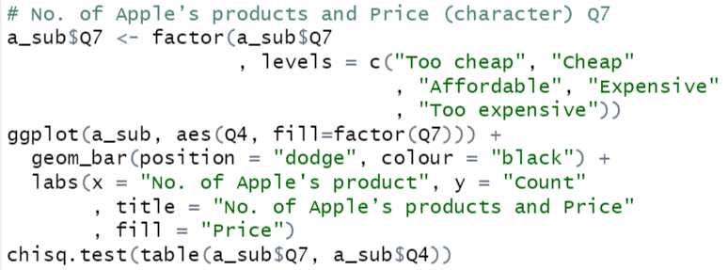
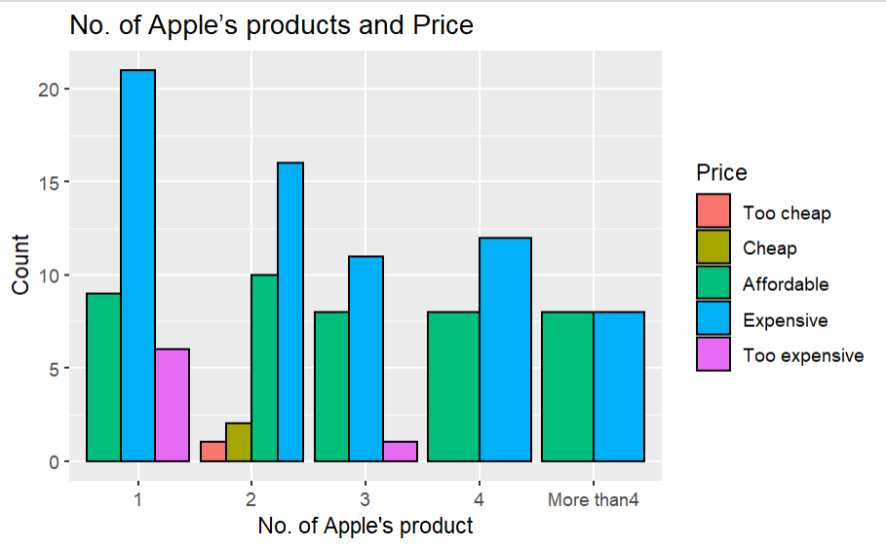
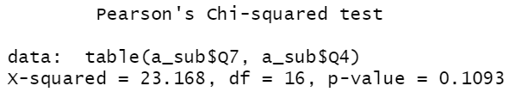
(3) No. of Apple’s products and Comments on Price
H0: Comments on Price and the number of Apple’s product are unrelated.
H1: Comments on Price and the number of Apple’s product are related.
P-value > 0.05
Not to reject H0.
So we conclude comments on price and the number of Apple’s product do not have a significant relationship.

Slide 13
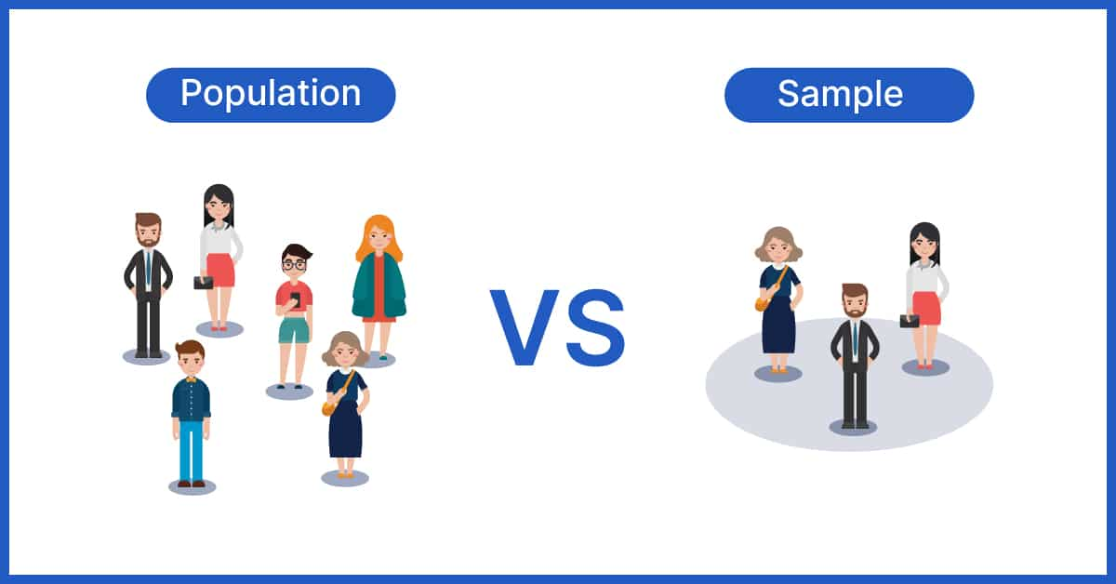



Sample Bias
Assumption
Sample bias
Previous funding
Normally they are correlated.
Our sampling methods are biased so that most of our responses are from students.
Age, income, and price are not related with number of Apple’s products customers have.

Slide 14
Analysis 4

Slide 15
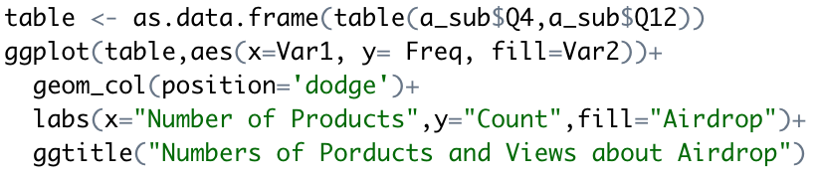
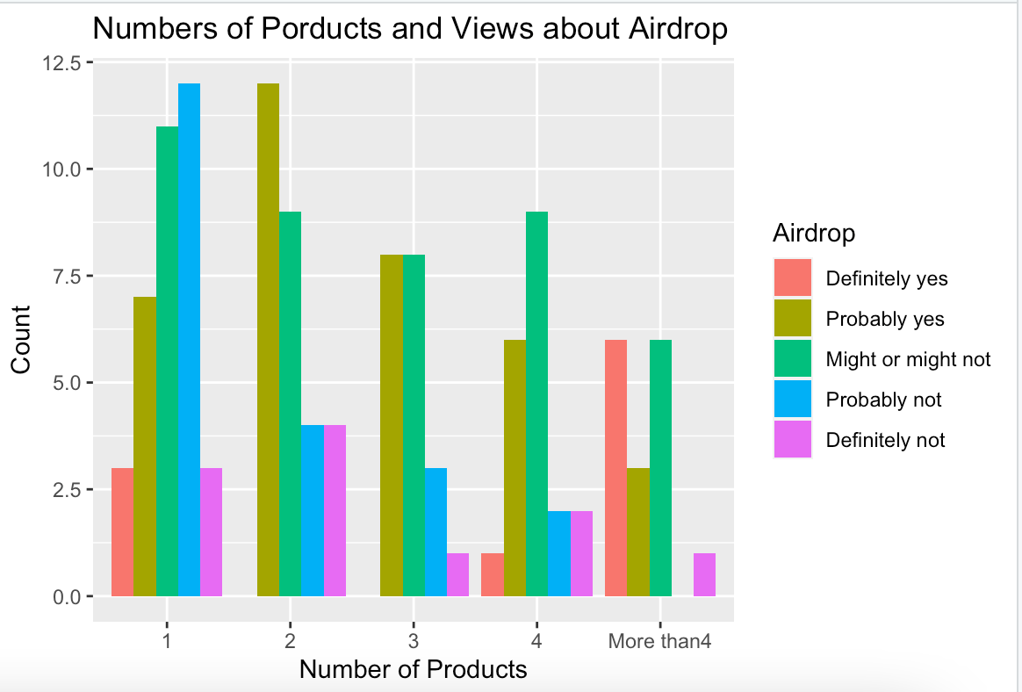
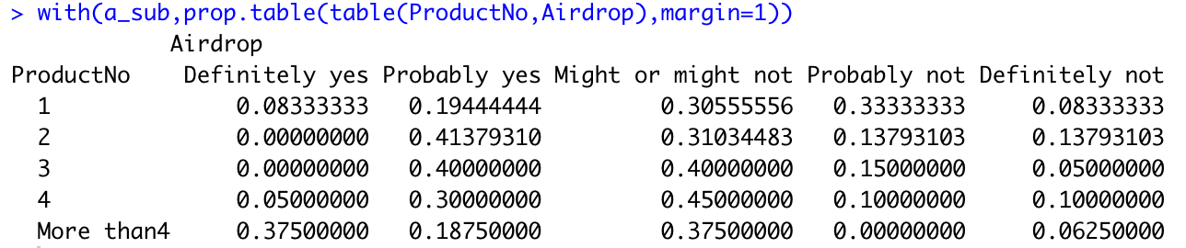
No. of Apple’s Products and Views About Airdrop

Slide 16
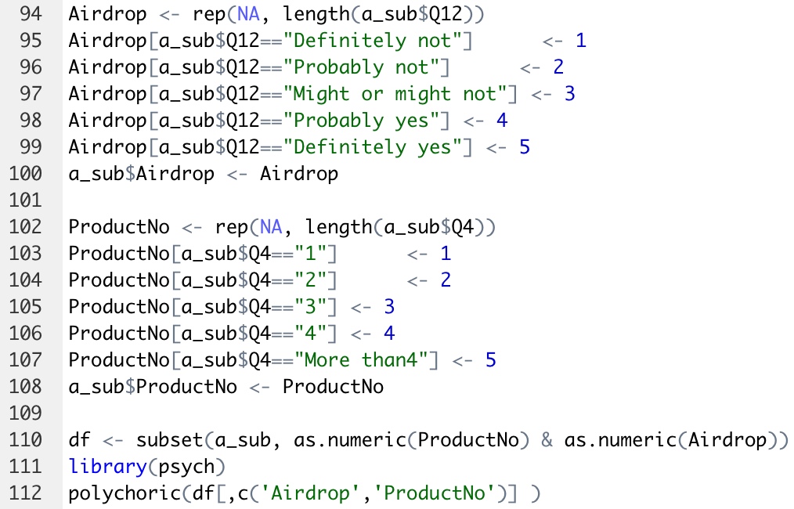
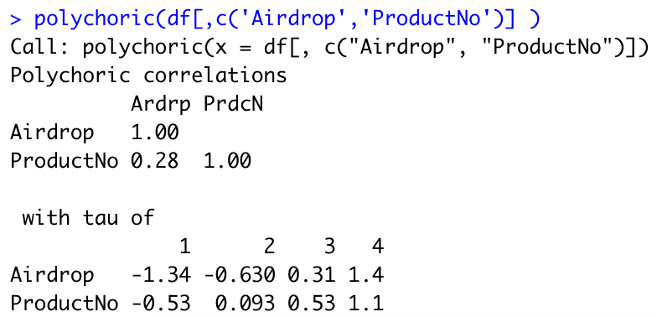
No. of Apple’s Products and Views About Airdrop (Continued)
The polychoric correlation coefficient is 0.28
4 cutting points for each variable

Slide 17
Analysis 5

Slide 18
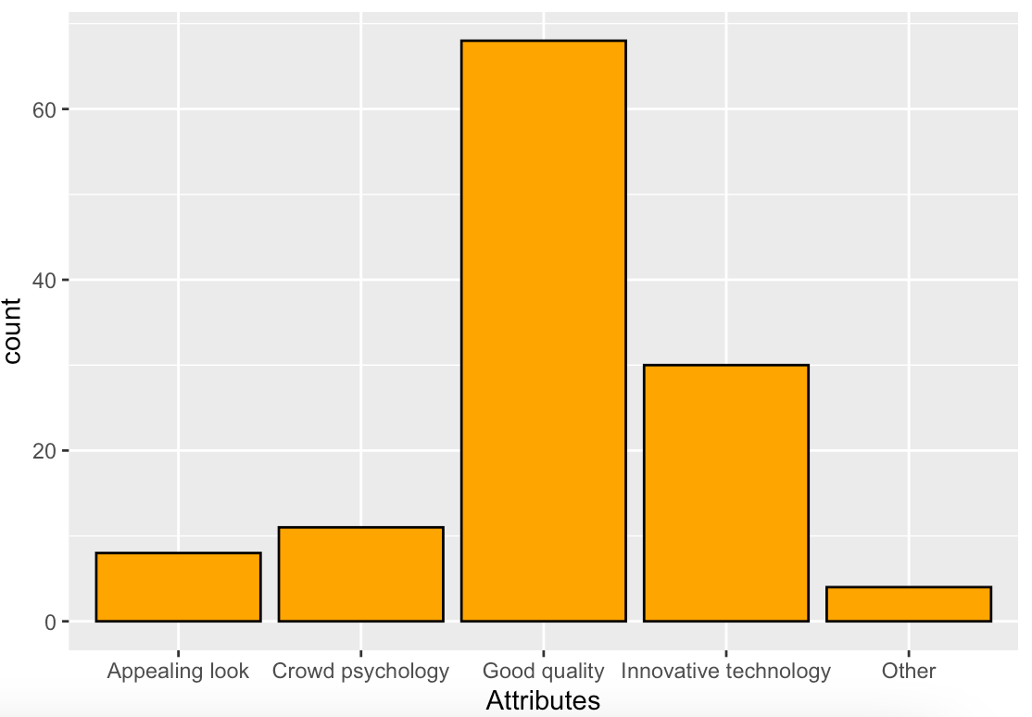
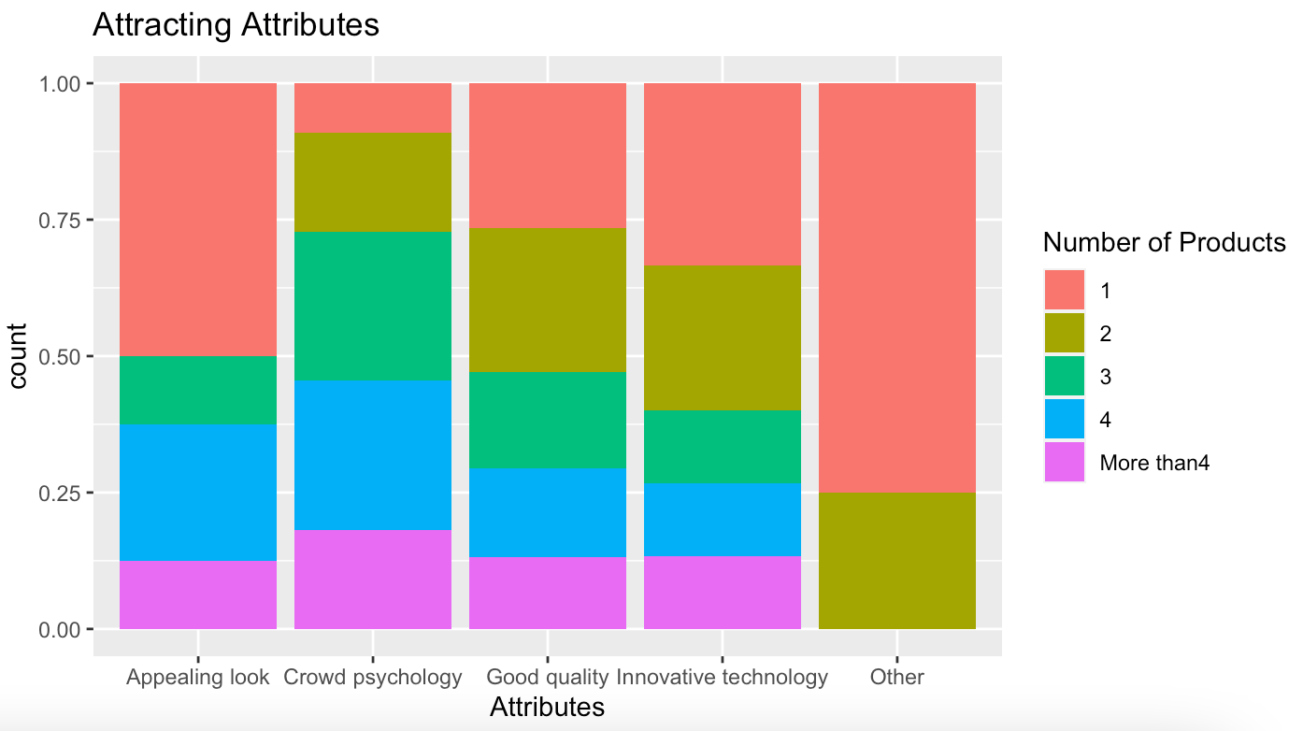
No. of Apple’s Products and Attracting Attributes
Most of customers who have more than 4 Apple’s products are attracted by Crowd Psychology attribute.
Most customers are attracted by Good Quality attribute.

Slide 19
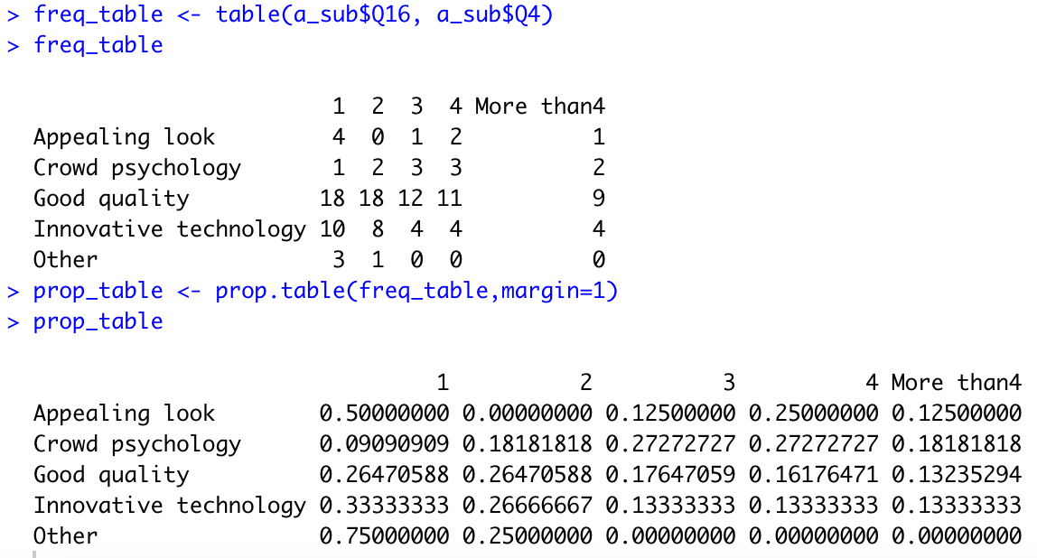
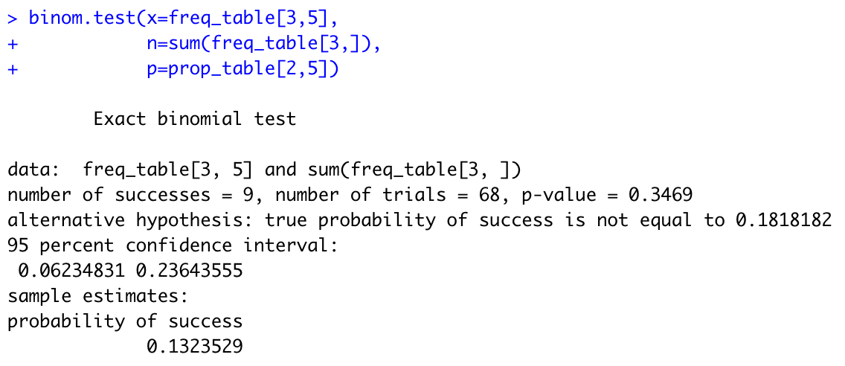
No. of Apple’s Products and Attracting Attributes (Continued)
Null hypothesis: true probability of success is equal to 0.18
P-value is not significant.
The 95 confidence interval [6%, 24%] does include the null value 18%
Do not reject the null hypothesis
Conclusion: True probability of success is equal to 0.18.

Slide 20
Analysis 6

Slide 21
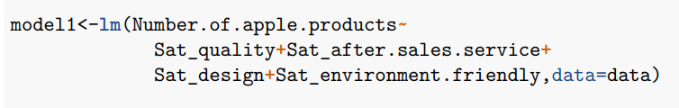
Average Effect of Satisfaction on
No. of Apple’s Products(1)
Multiple Linear Regression

Slide 22
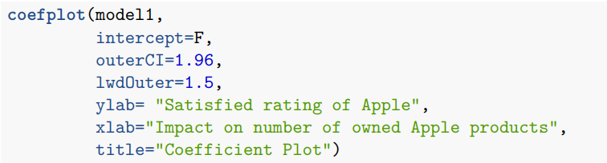
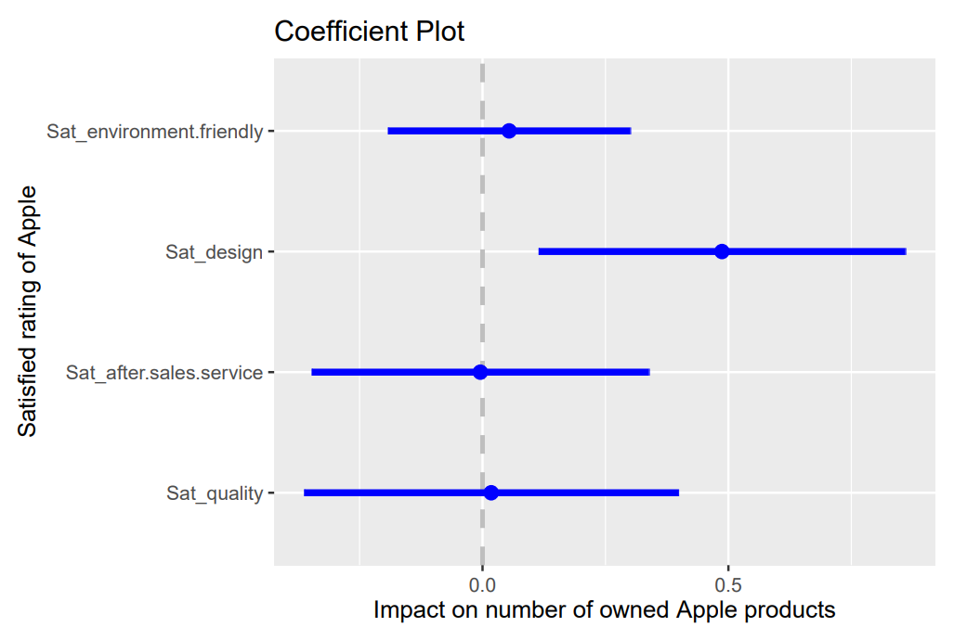
Average Effect of Satisfaction on
No. of Apple’s Products(2)
Visualize by Coefficient Plot

Slide 23
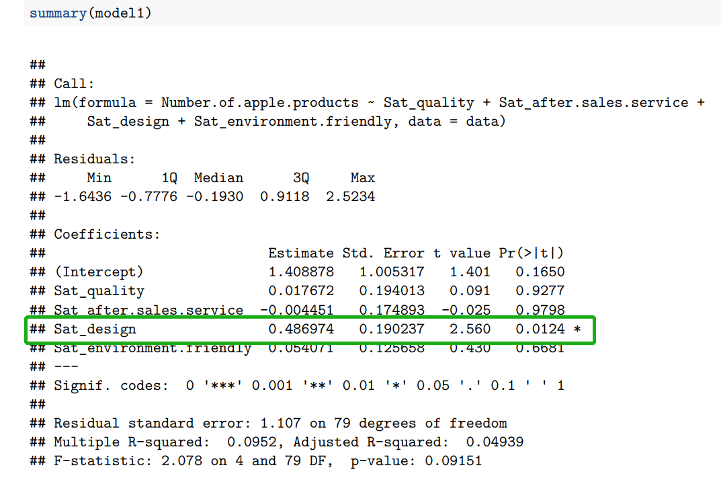
Average Effect of Satisfaction on
No. of Apple’s Products(3)
Useful Factor:
Sat_design
P value < 0.05

Slide 24
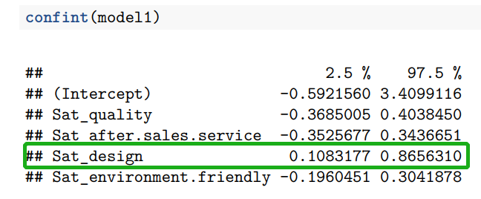
Average Effect of Satisfaction on
No. of Apple’s Products(4)
Check with 95%
Interval
No Include 0

Slide 25
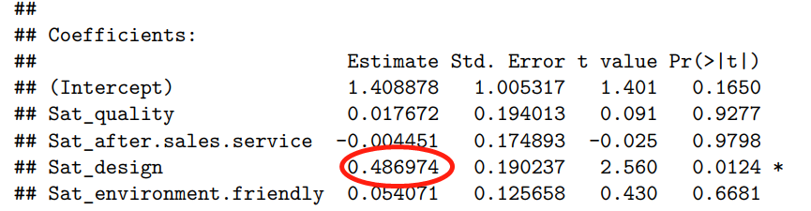
Average Effect of Satisfaction on
No. of Apple’s Products(5)
Make a prediction
If customers’ satisfaction on design increases by 2.08 unit,
his or her no. of having apple’s products may increase 1 unit.

Slide 26
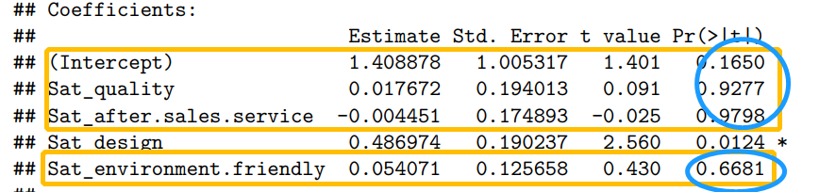
Average Effect of Satisfaction on
No. of Apple’s Products(6)
Cannot make predictions
from intercept, quality, after-sales
services and environmental-friendly
P values > 0.05

Slide 27
Suggestions

Slide 28

Bias issue
Issue: Getting results of no relationship between factors (Analysis 1-3&6)
Possible reasons:
Not having enough responses
Small sample size
Narrow age sample
University students only

Slide 29
Situation Analysis (1) - Design
If customers’ satisfaction on design increases by 2.08 unit, his or her no. of having apple’s products may increase 1 unit
Customer satisfaction is fulfilled on its design
Apple’s products design: minimalism (Attracting point)
However, there are still some problems with the design that can be improved

Slide 30
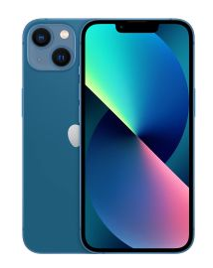
Suggestion (1) - Design
Minimize the size of the notch or even removing it
Many iPhone users has mentioned this problem
→ In line with the public’s aesthetics
Due to the relationship between satisfaction on design and number of Apple products the customers willing to buy
Increase competitiveness on exterior design, not only iPhone
Increase their sales

Slide 31
Situation Analysis (2) – Airdrop
Weak positive polychoric correlation (0.28) between customers’ view of Airdrop and the number of Apple products they own
Purpose of Airdrop:
allow users to share photos and documents with other Apple devices nearby
Apple Ecosystem: encourages customers to use different Apple products by allowing the interaction between devices
Weak positive correlation: Many users may be unaware of the Airdrop function

Slide 32
Suggestion (2) – Airdrop
Promotion: commercials and advertisements to promote the advantages of using Airdrop
Privacy Protection: uses peer-to-peer network connection with the receiving devices instead of the Internet
No limit to file size
Demonstrate how Airdrop can be used across different Apple products
Encourage customers to purchase multiple Apple products

Slide 33
Suggestion (3)
Factors that May Attract Customers:
Good Quality: known for high quality products
Attracts most of its customers
Crowd Psychology: popularity of Apple attracts many customers
Encourages customers to purchase more than 4 products
Satisfaction on Design: predicted that satisfaction on design is positively related to the number of Apple products owned by customers
Keep improving on quality and design to maintain brand image
To attract customers and increase sales

Slide 34
THANKS

